Slide 1
Analytics Project
Agriculture Business Domain 20th October 2024

Slide 2
Crop Production and Yield Analysis

Slide 3
Objective :
This project analyzes agricultural crop production data from various states and districts in India over multiple years. The objective is to predict the crop production and find important insights that influence the crop production.
Analysing data using SQL and data visualization using powerbi

Slide 4
Dataset Description :
dataset file name : Crop_prod_study.csv
Number of columns : 7
Rows/records: 246091
Column names and data types
State_Name: (text)Name of the state where the crop was grown.
District_Name: (text)District within the state.

Slide 5
Crop_Year: (Whole Number)Year of crop production.
Season: (text)Season in which the crop was grown (e.g., Kharif)
Crop: (text)Type of crop produced.
Area: (Decimal Number)The area (presumably in hectares) used for cultivation.
Production: (Decimal Number)The crop production output (presumably in metric tons).

Slide 6
Insights From SQL
Sugarcane have the highest yield i.e., 40000 kg/ha making it the most efficient crop in terms of production per unit area. coconut,onion and maize are few more crops efficient in production.
Puducherry,Kerala,Punjab,Andaman and Nicobar Islands and Goa are top 5 states with hishest average yield over multiple years.
Arecanut,banana,Arhar/tur etc are crops which shows high varience in production in the states like Andaman and Nicobar Islands, Andhra Pradesh, Arunachal Pradesh.

Slide 7
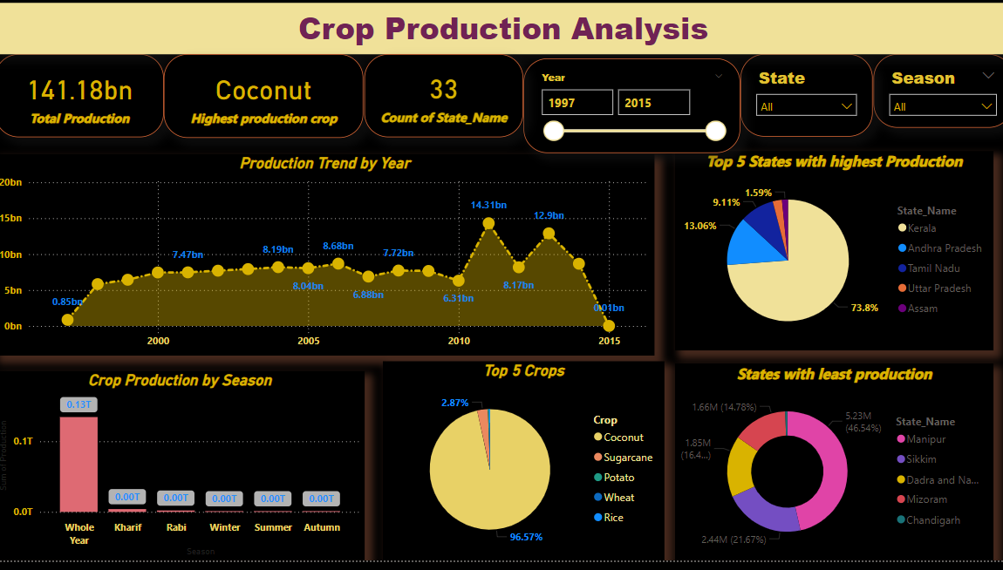
Power BI Report:

Slide 8
Insights from Power BI:
Kerala,Andrapradesh,Tamil Nadu,Uttar Pradesh and Assam are the top 5 states with highest crop production.
Kerala contributes 73.8 % in the production and Coconut is majorly grown.
Coconut, Sugarcane, Potato,Wheat and Rice are the key crops majorly grown in the most of the states.
2015 was the least production year. Odissa and Sikkim contributes to the production

Slide 9
Thank You

